Slide 1
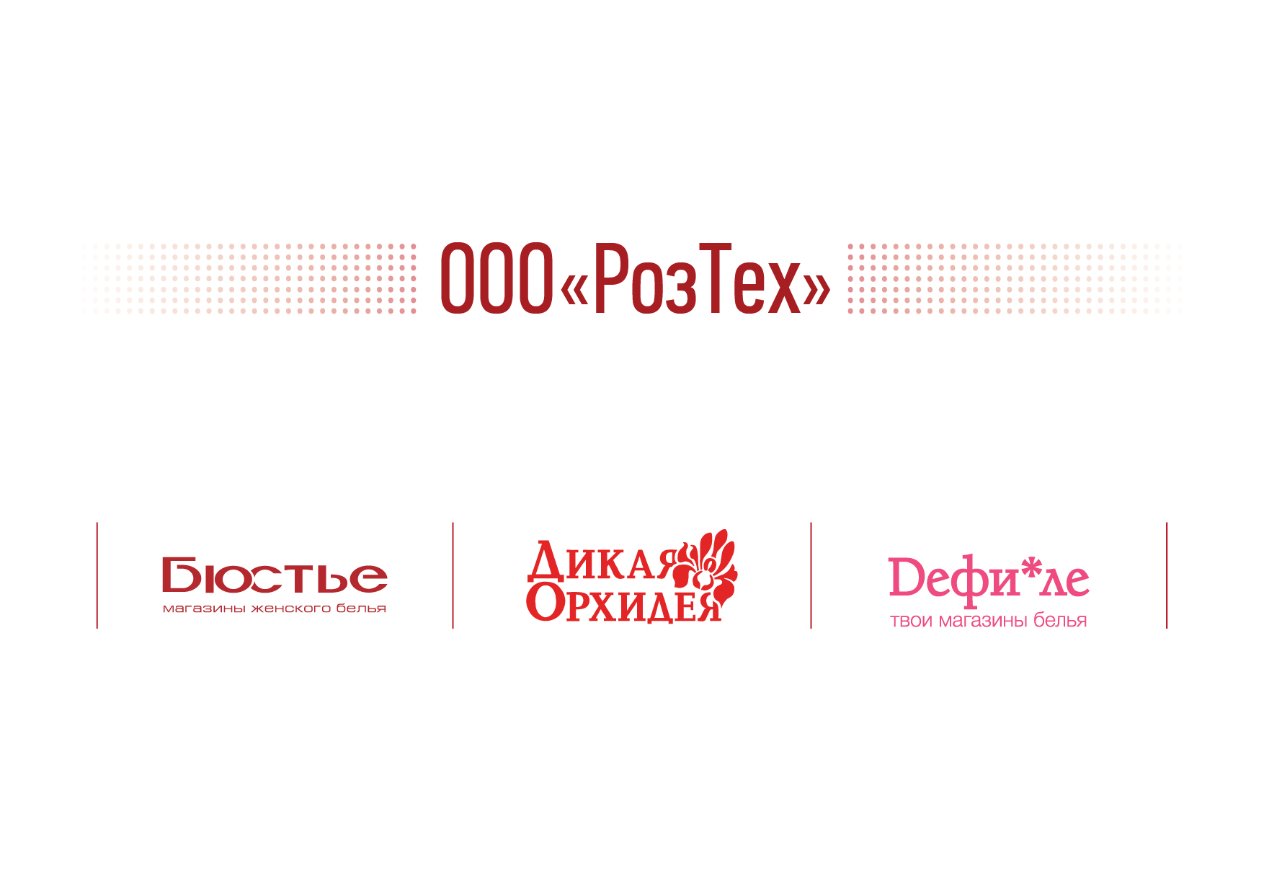
PRODUCTION PLATFORM

Slide 2




About us
Our specialization is lingerie, homewear and beachwear’s development and production.
We produce products for «Wild Orchid», «Bustier» and «Defile» retail chains.
We produce 2 mln. pcs. per year.
We have production facilities in Russia and in Ukraine.

Slide 3
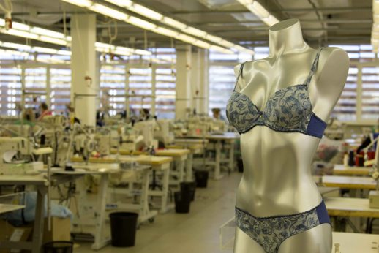
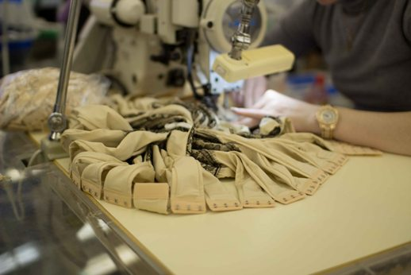
Production capacity of our factories
Database | Gagarin | Gol'evo | Ukraine
Space of sewing workshops | 1450 sq. m. | 280 sq. m. | 450 sq. m.
Location | Smolensk district, Gagarin, Russia, 180 km. away from Moscow | Administrative building of Terminal Euroservice Co.Ltd, Golievo village, Krasnogorsk district, Moscow region, Russia, 5 km. away from Moscow | Lubny region, Ukraine, 190 km. away from Kiev
Number of operators | 250 | 35 | 120

Slide 4
Manufacturing cost
MOQ for Gagarin factory - 1500 pcs., min for item – 500 pcs.
Gagarin
Min per item | Range 500 - 999 pcs. | Range 1000 - 3000 pcs. | Range 3000 – and more
Сost per minute, RUB* | 13.00 | 10.00 | 8.50
MOQ, pcs. | 1,500 | 5,000 | 20,000
Gol’evo factory
Gol’evo
Min per item | 150 pcs.
Сost per minute, RUB* | 20.00
* Price in RUB (except VAT)

Slide 5
Product categories
Type of products | Women's garment | Men's garment | Children's garment
Underwear * | + | + | +
Loungewear | + | + | +
Homewear | + | + | +
Sportswear | + | + | +
Accessories ** | + | + | +
* Including swimwear
**Sleep masks, garters, beach bags, gloves, covers for mobile phones, etc.

Slide 6
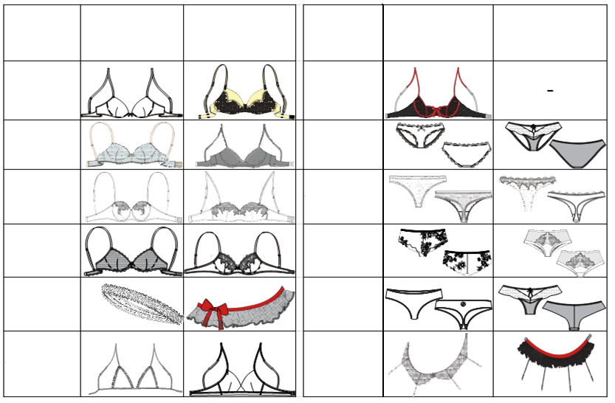


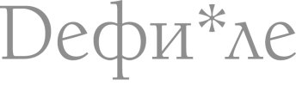
Range of products
Range of products
Product
photo
Product
photo
photo
photo
Push-up bra
Moon-
Half bra
Bustier
Slip
Balconet
String
Classic bra
Shorts
Garter
Hipster
Triangle bra
Garter belt

Slide 7
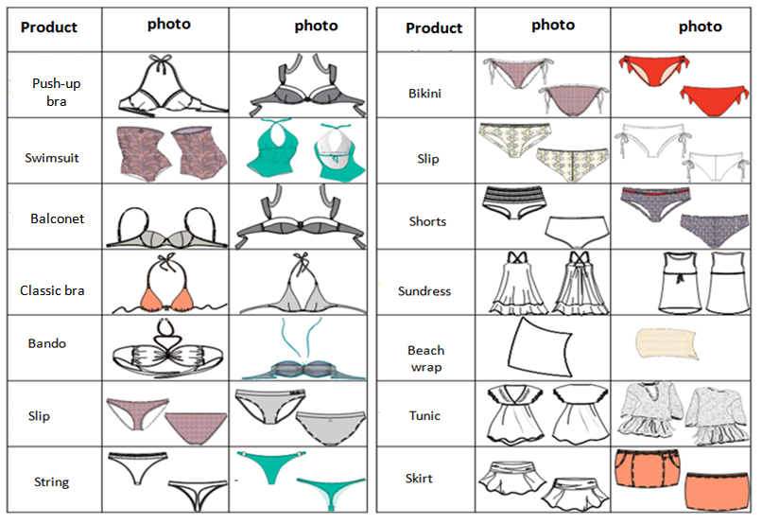
Range of products

Slide 8
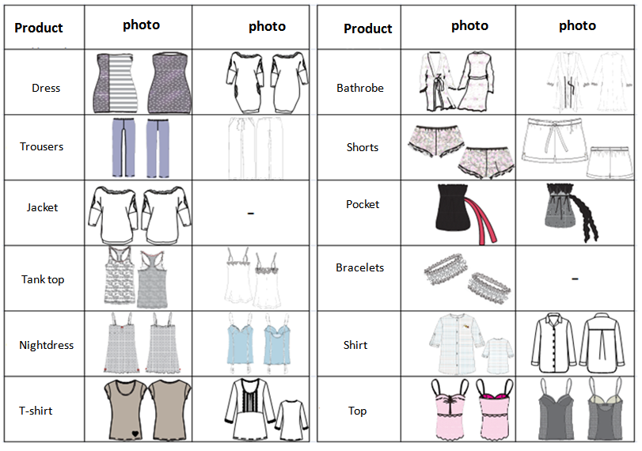
Range of products

Slide 9
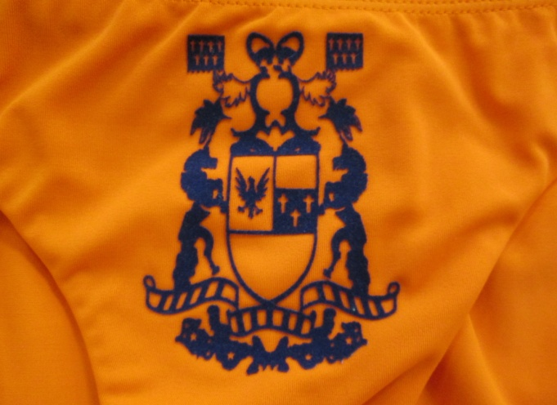
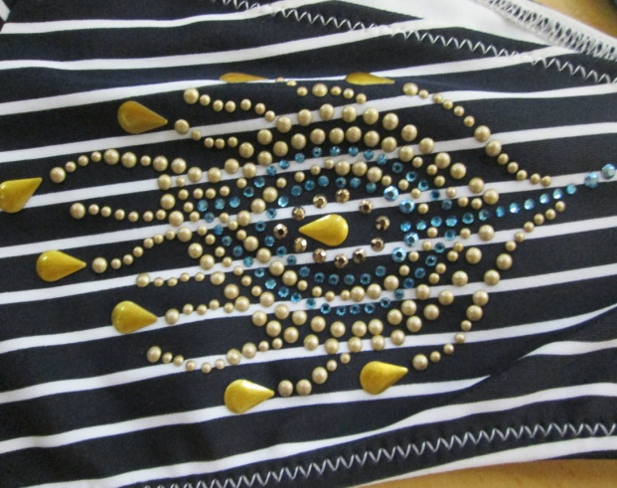
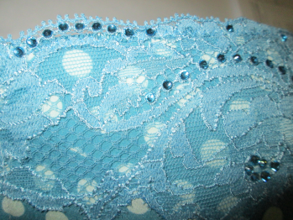
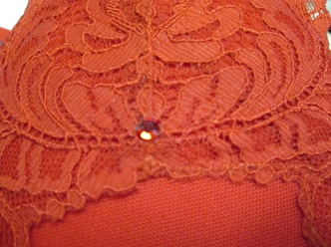
Additional capability
Type of equipment | Example
Press for thermo appliqué
Ultrasonic machine for strass decorating (for any materials)

Slide 10
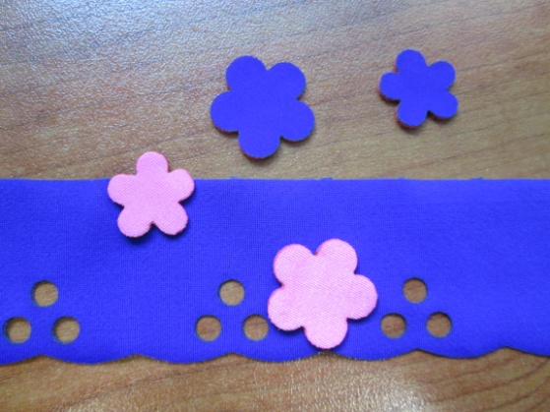
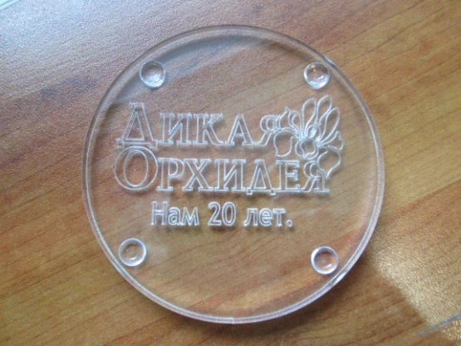
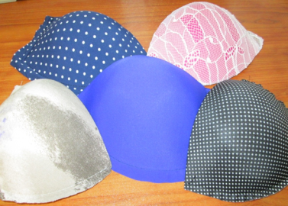
Additional capability
Type of equipment | Example
Laser
Molding machine (molding cups of knitted fabrics and textile materials)

Slide 11
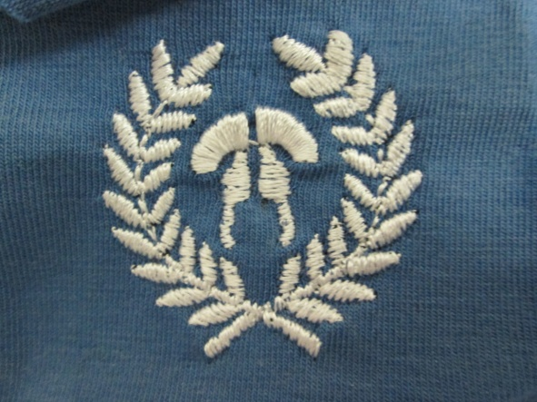
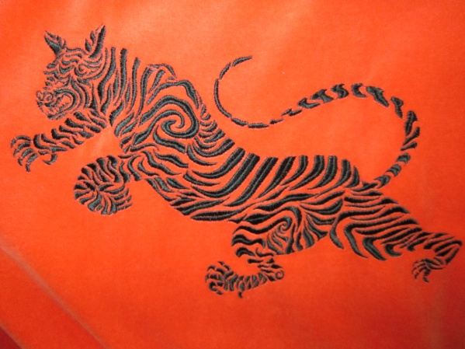
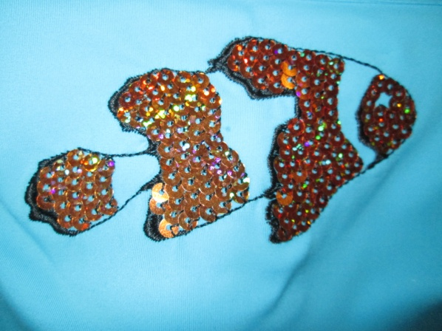
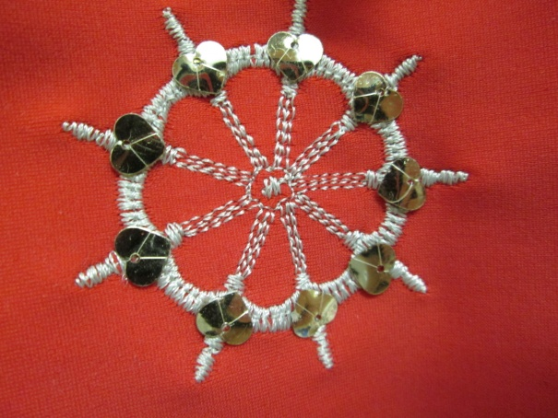
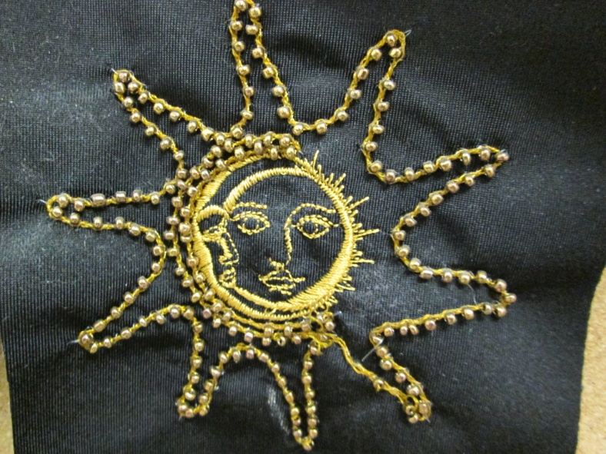
Additional capability
Type of equipment | Example
Embroidery machine with program control | 1. embroidery regular
 | 2. Combined embroidery (embroidery satin + sequins)
 | 3. Cords embroidery with beads, sequins, bugle beads

Slide 12
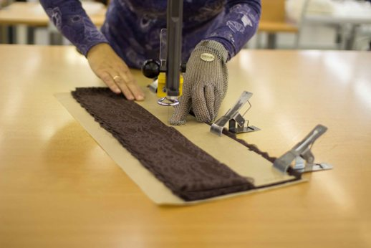
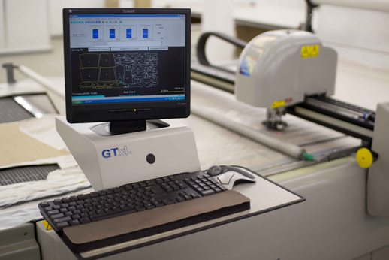
Cutting capacity
Location | Smolensk district, Gagarin, Russia, 180 km. away from Moscow
Number of operators | 64
cutting tool, q-ty | 7
Additional facilities, q-ty | 5
Definition of facilities | Сloth-cutting machine GERBER CUTTER GTxL - 2 psc., Сloth spreading machine GERBER SPREADER XLS 125 - 2 pcs., Drawing-cutting machine KURIS - 2 pcs., Drawing-cutting machine HOFFMAN - 1 pcs., Laser cut machine RABBIT 600*900, Fabric Measuring-and-inspecting machine* - 2 pcs., Plotter INFINITY, Automatic pattern lay program (AccuNest Gerber)
Main specialization | Middle and sheer cutting, including textile fabric and lace
* Width of the material - not more than 1,70 m.
* Roll diameter - not more than 0,4 m.
* Roll weight - not more than 60 kg.

Slide 13

Our offers
Goods made on commission
Product development (pattern making, grading)
Development of technical documentation for production
Selection of materials
Cutting

Slide 14
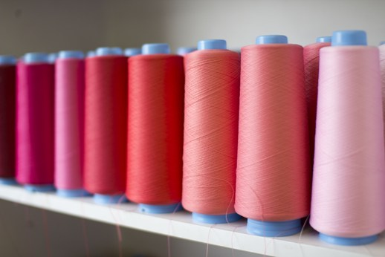
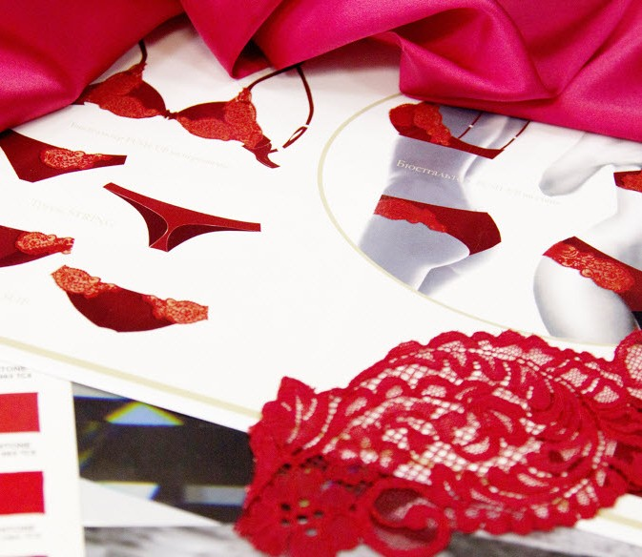
Contact Information
Russia, Moscow
Tel.: +7 (495) 225-24-25
Fax: +7 (495) 644-34-00
Mobile: +7 (968) 712-59-80
E-mail: OKlementieva@wildorchid.ru
Web: www.mfwo.ru

